Slide 1
Gas Detector Selection and Placement
Jon Boykan, PE
Sales Engineer
Gilson Engineering Sales

Slide 2
If you require a PDH certificate, please send a chat message with the following info:
- Your name
- PE# and state
- email address

Slide 3
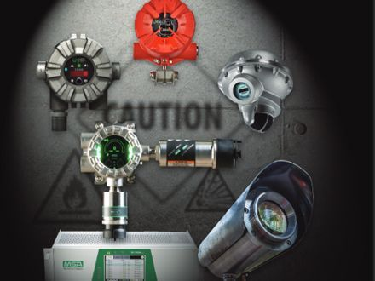
Gilson Engineering is now the representative for MSA fixed gas detection products in Florida

Slide 4
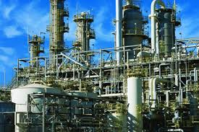

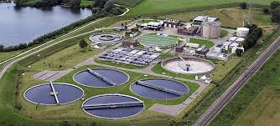
Where are Ambient Gas Detectors Installed
Chemical Plants
Refineries
Water and Wastewater Plants
Gas and Chemical Storage
Office Buildings
Parking Garages (CO, NO2)
Your House (CO)

Slide 5
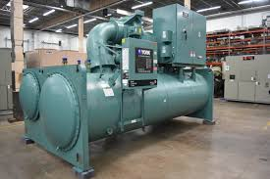
Where do I install Gas Detectors
IEC 60079-29-2.
Gives guidance on sensor technologies, and general ‘rule of thumb’ suggestions as to where combustible gas and Oxygen sensors should be located.
ASHRAE 15
States that a refrigerant monitor capable of detecting the TLV for a refrigerant gas must be installed in a mechanical equipment room.

Slide 6
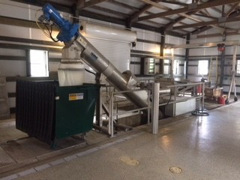
Where do I Install Gas Detectors
NFPA-820 (Standard for Fire Protection in Wastewater Treatment and Collection Facilities)
Sec A-5-4.2 ‘Other types of detectors, such as heat and smoke detectors, have standards recommending spacing usually based on a certain area per detector. There are no known recognized standards or guidelines for the locating or spacing of combustible gas detectors’.

Slide 7
Sample from NFPA-820

Slide 8
Where do I install Gas Detectors
ISA TR 84.00.07
This report describes coverage and safety availability of fire and gas detection systems. Similar to Safety Instrumented Systems (SIS).
Covers geographic coverage, and scenario based coverage (if this valve fails, will the leak be detected).
Computational Fluid Dynamics (CFD) modeling of gas releases
Third parties can perform this service: >$10K/site

Slide 9
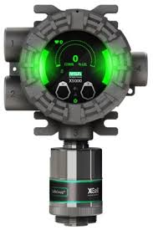
Question
What is the sensing range of a combustible gas point detector?
Answer: about 0.00001”
The gas has to get to the sensor

Slide 10
Sensor Placement
Place sensors in areas where the air currents are likely to produce the highest gas concentration, including areas where gas buildup is likely, such as corners or stopping points of moving devices that release gas.
Place sensors close to the possible gas / leak source.
Factor in the vapor density of the monitored gases, when compared to air.
Consider ease of access to the sensor for maintenance requirements, such as periodic calibration. Use a remote sensor for high or inaccessible locations.
Place combustible gas sensors between the potential leak and the ignition source
Place toxic (and oxygen deficiency) sensors between the potential leak and the populated area.
If the hazard is outside, place sensors near the air intake for both combustible and toxic gas monitoring; if the hazard is inside, place sensors near the exhaust.
Consider using smoke tubes to map ventilation routes.
Gas detectors monitor gas clouds, not leaks.

Slide 11
Other Considerations
Ambient temperature limits. Is the gas detector rated for the temperature extremes if mounted outdoors.
Poisoning. Will the gas detector be mounted in a location where it can be ‘poisoned’ or damaged by other gases.
Flooding. Is there a chance the gas detector could become submerged
Vibration. Like any electronics, gas detectors can be damaged by high vibration.
Economics. The more sensors you add, the quicker you should detect an event, but at what cost.

Slide 12
Question
Where would I place a gas detector looking for the LEL of Propane?

Slide 13
Question
Where would I place a gas detector looking for the LEL of Propane?
Answer:
The specific gravity of Propane is 1.52, so we need to place it near the floor

Slide 14
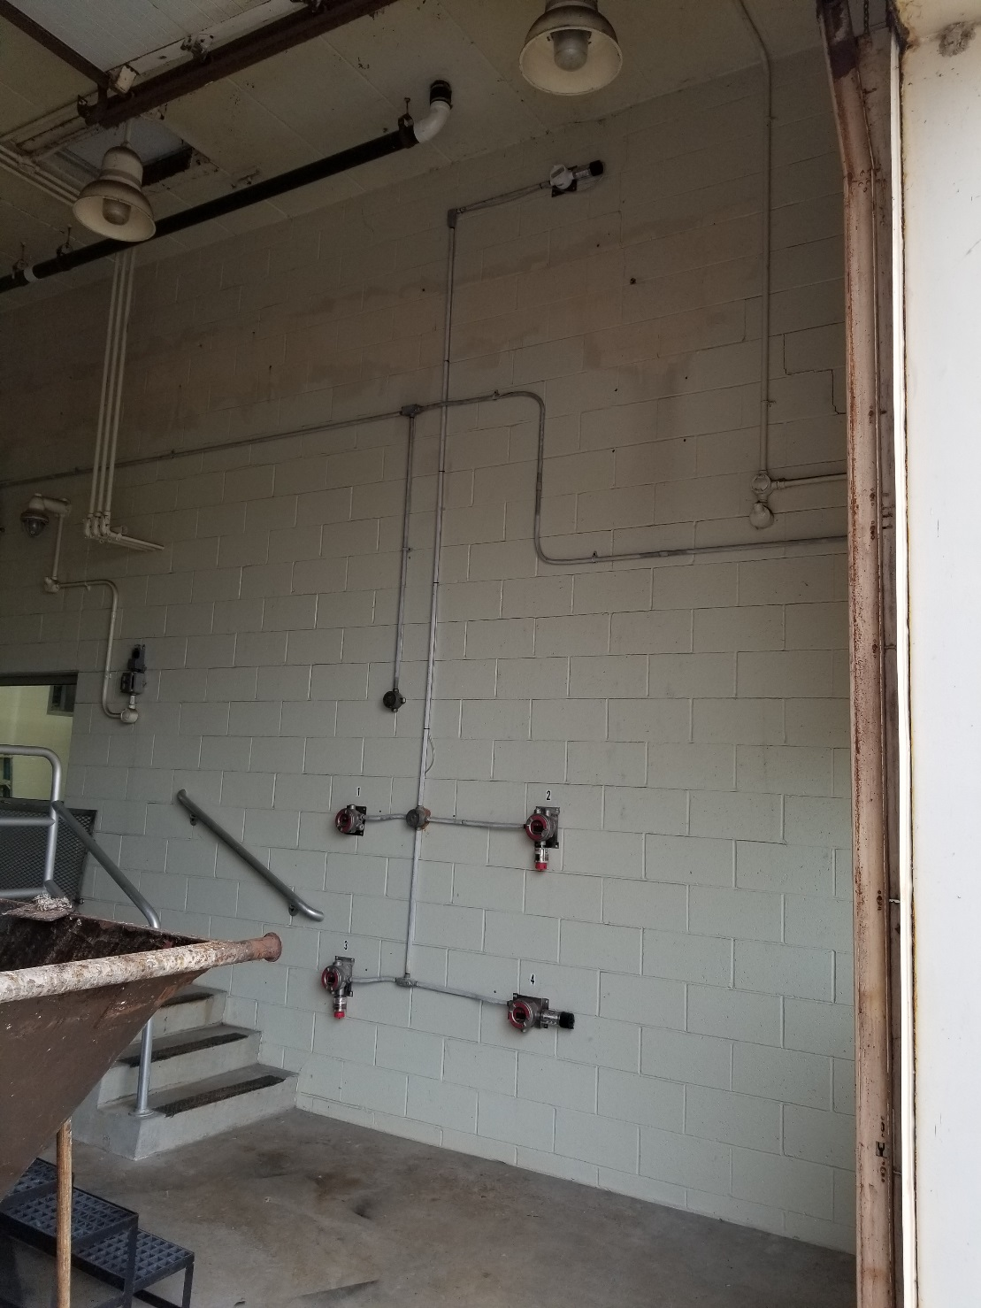
Typical WWTP Screen Bldg
Methane Sensor High
Oxygen Sensor Head Height
H2S Sensor Low
Petroleum Vapor Sensor Low
Methane sensor
Oxygen sensor
Petroleum vapor
sensor
H2S sensor

Slide 15
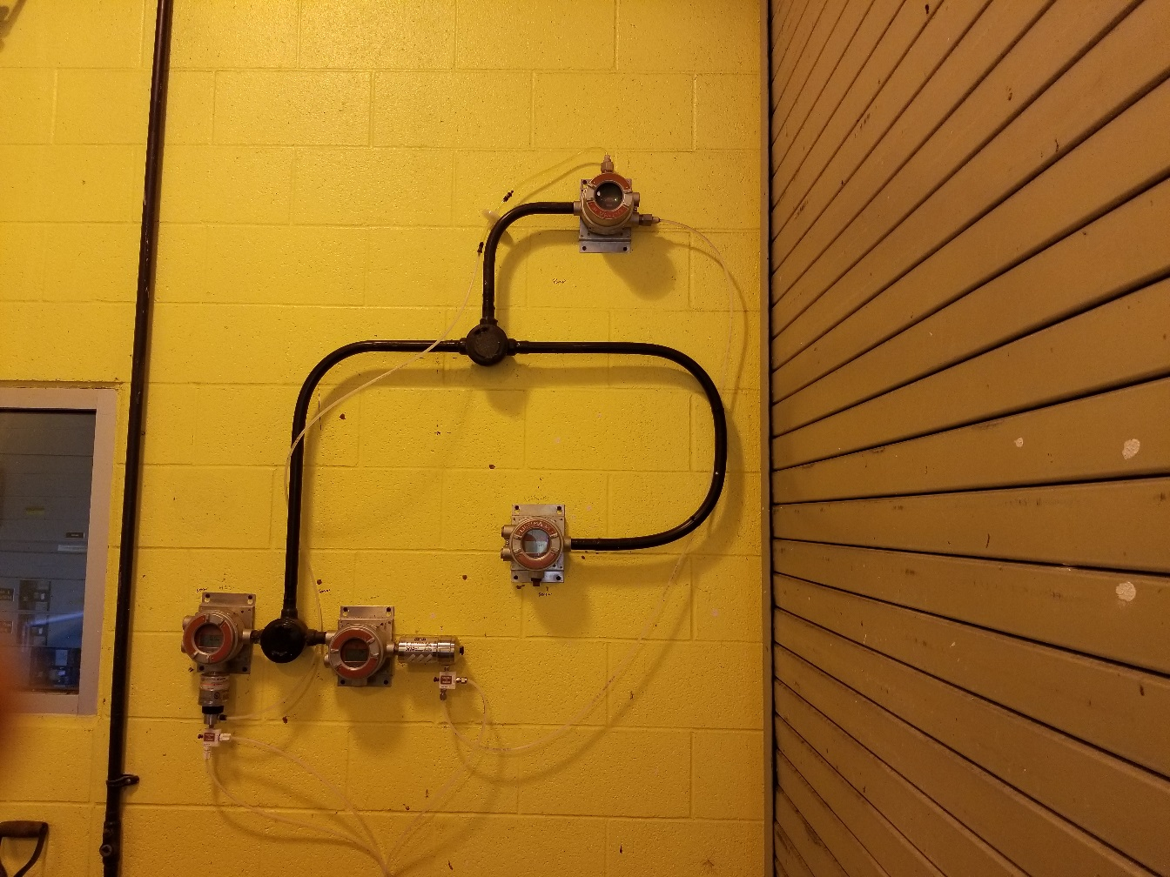
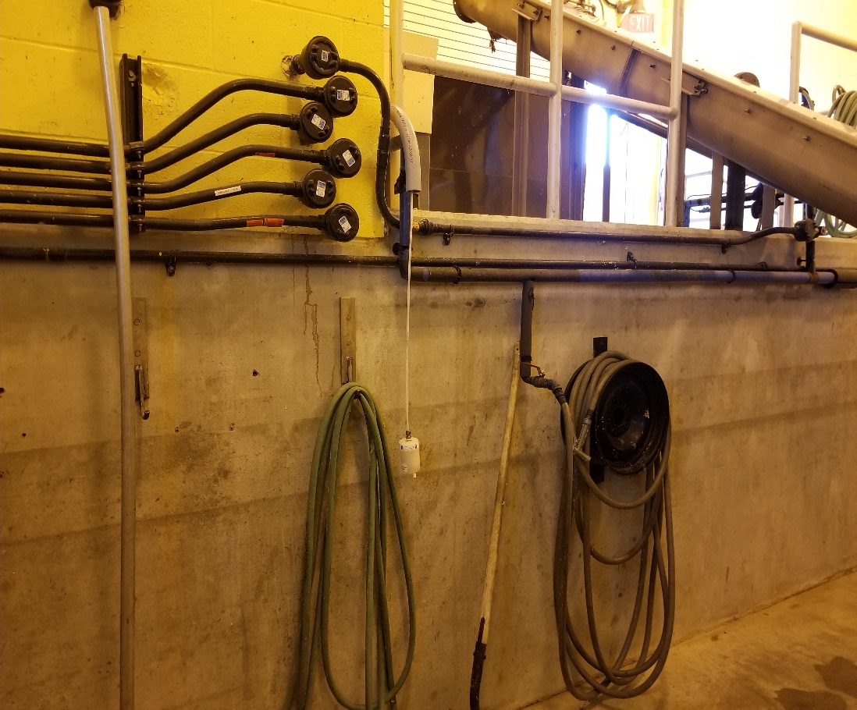
What if the area I want to sense may flood?
Pump module
Monitoring area below grade
H2S and LEL Sensors
Sample line with filter
Monitoring equipment above grade

Slide 16
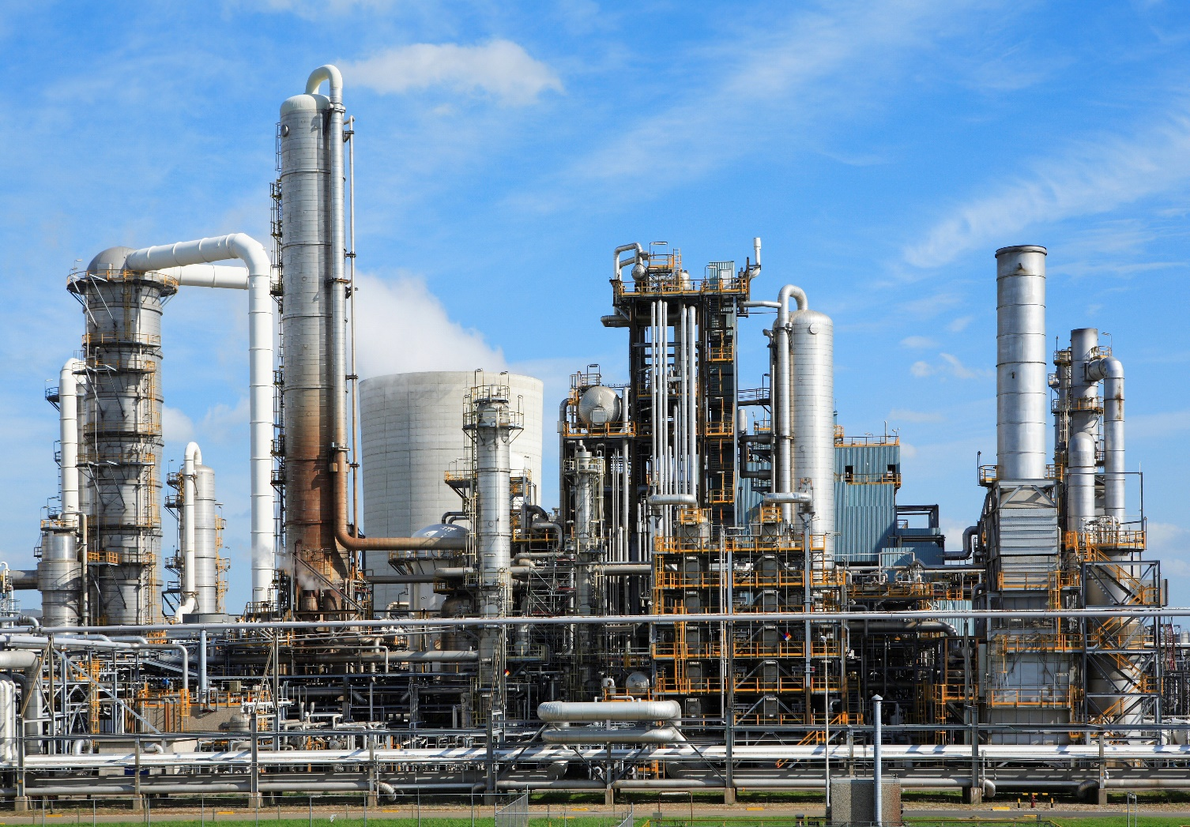
What if I want to monitor for gas outdoors over a large area?

Slide 17
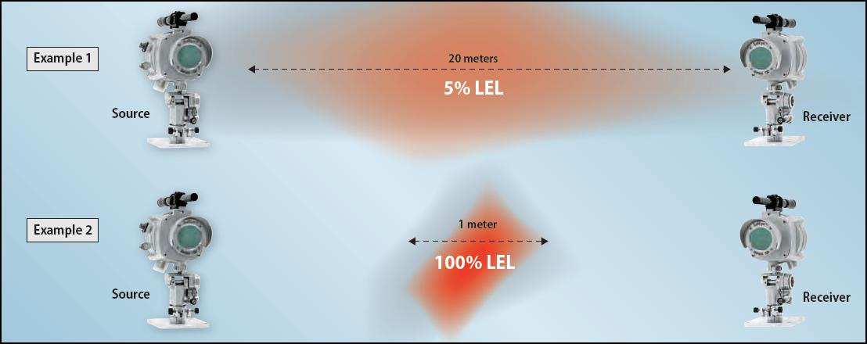
Option for monitoring gases outdoors

Slide 18
Open Path Gas Detectors available for the Following Gases
Methane (Natural Gas)
Propane
Ethylene
Ammonia
Hydrogen Fluoride
Carbon Dioxide
Hydrogen Chloride
Hydrogen Sulfide

Slide 19
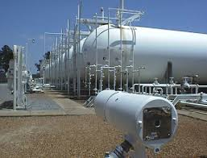
Open Path Gas Detectors available for the Following Gases
Methane (Natural Gas)
Propane
Ethylene
Ammonia
Hydrogen Fluoride
Carbon Dioxide
Hydrogen Chloride
Hydrogen Sulfide
Need to keep clear line of sight between source and detector

Slide 21


Slide 22


